Slide 1
Forms of Business Organization

Slide 2


Objectives
Describe the advantages and disadvantages of the three major forms of business organizations.
Describe how cooperatives and nonprofits are like and unlike corporations and franchises.

Slide 3
The Main Idea
Sole proprietorships, partnerships, and corporations are the most common forms of business organization.
Cooperatives, nonprofits, and franchises are other forms.

Slide 4
Key Term
sole proprietorship
a business owned by one person
unlimited liability
when the owner is responsible for the company’s debts

Slide 5
Key Term
a business owned by two or more people who share its risks and rewards
partnership
a company that is registered by a state and operates apart from its owners
corporation

Slide 6
Key Term
holding a firm’s owners responsible for no more than the capital that they have invested in it
limited liability
an organization that is owned and operated by its members
cooperative

Slide 7
Key Term
a type of business that focuses on providing service, not on making a profit
nonprofit organization
a contractual agreement to use the name and sell the products or services of a company in a designated geographic area
franchise

Slide 8
Organizing a Business
The three main types of business organizations are:
Sole Proprietorships
Partnerships
Corporations

Slide 9
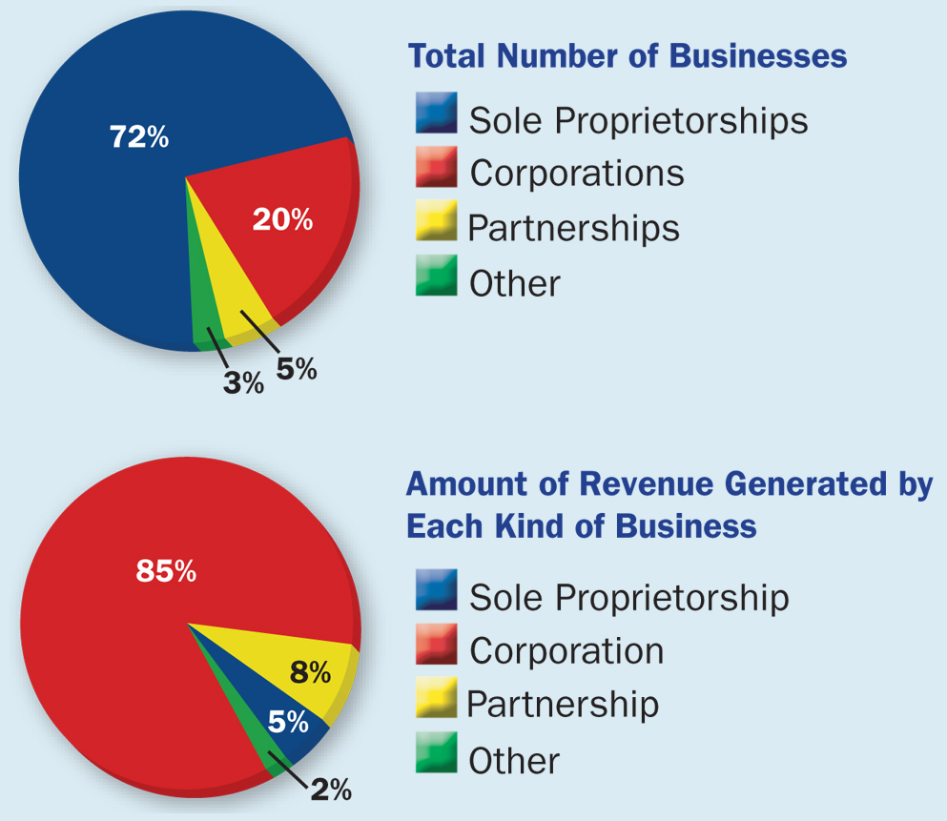
U.S. Sole Proprietorships, Partnerships, and Corporations

Slide 10
sole proprietorship a business owned by one person
Advantages of Sole Proprietorships
Easy to start
Proprietors are in charge
Proprietors keep all the profits
Taxes are lower than a corporation’s

Slide 11
Sole Proprietorships
A major disadvantage of owning a sole proprietorship is that the owner has unlimited liability.
unlimited liability
when the owner is responsible for the company’s debts

Slide 12
Disadvantages of Sole Proprietorships
Limited access to credit
Many run out of money
The owner may not have the necessary skills
The business ends when the owner dies

Slide 13
Partnerships
To start a partnership, you need a partnership agreement.
partnership
a business owned by two or more people who share its risks and rewards

Slide 14
Advantages of Partnerships
Easy to start
Easier to obtain capital
Easier to obtain credit
Not dependent on a sole person
Diversity in skills

Slide 15
Disadvantages of Partnerships
Business risk is shared
Unlimited legal and financial liability is shared
If one partner makes a mistake, all partners are responsible

Slide 16
Corporations
To form a corporation, the owners must get a corporate charter from the state where their main office will be located.
corporation
a company that is registered by a state and operates apart from its owners

Slide 17
Corporations
Limited liability is a major advantage of a corporation.
limited liability
holds a firm’s owners responsible for no more than the capital that they have invested in it

Slide 18
Advantages of Corporation
Limited liability
Ability to raise money by selling stock
Business does not end when an owner dies

Slide 19
Disadvantages of Corporation
Double taxation
More government regulation
Difficult and costly to start
Income is taxed.
Stockholders pay taxes on profits issued to them

Slide 20
Other Ways to Organize a Business
Other ways to organize a business include:
Cooperative
Nonprofit Organization
Franchise

Slide 21
Other Ways to Organize a Business
The purpose of a cooperative is to save money on the purchase of certain goods and services.
cooperative
an organization that is owned and operated by its members

Slide 22
Other Ways to Organize a Business
A nonprofit organization does not pay taxes because it does not make a profit.
nonprofit organization
a type of business that focuses on providing a service, not making a profit

Slide 23
Other Ways to Organize a Business
To run a franchise, you have to invest money and pay franchise fees or a share of the profits.
franchise
a contractual agreement to use the name and sell the products or services of a company in a designated geographic area

Slide 24
What is the difference between a sole proprietorship and a partnership?
A sole proprietorship is owned by one person. A partnership is owned by two or more people.

Slide 25
If a partner makes a bad decision, what responsibility do the other partners have?
All partners share responsibility for a
bad decision.

Slide 26
Why are cooperatives formed?
so that the members have advantages
in buying and selling products and
services

